Slide 1
Patent Landscaping introduction
By Alan Malvern
October 2016

Slide 2
After this session you should:
Know what a patent is
Know what is required of a patent
How do you get a patent?
Start to prepare the project to identify the key features
Understand what is required in the patent landscape
Second lecture will go through patent searching in detail

Slide 3
What is a patent?
An Intellectual property right
A deal between the government and an inventor
Public domain disclosure
But 20 year monopoly on use
Prevents others using the idea so inventor is free to benefit
A negative right-prevents others using the idea
A legal document
Enforceable in a UK court of law(for UK patents)
What does the government get out of it?
Dissemination of information
Everyone is better informed of technology so society benefits
A source of ideas for all to study
Freely available in the public domain at no cost
Sets a legal framework for ideas
Clarifies the position to avoid unnecessary disputes

Slide 4
What is a patent?
What does the inventor get out of it?
An opportunity to make monopoly profits on their idea without competition
For the 20 year duration if renewal fees are paid if patent granted
Does not help development but prevents competition
A possibility of licensing the ideas to others
Royalty payment for others to use it
Something which may have tangible value
Patents can be sold/traded and from part of the value of a company
However need a willing buyer
Something to encourage investors
Confidence that there is a high barrier to compete
Most investors look for a granted patent
Prevents others from legally doing it(blocking even if inventor does not use it)

Slide 5
What does it comprise?
Invention description
What is the problem being solved?
May solve a range of problems
What are existing solutions?
Called “prior art”
Existing patents/published articles
What is the novelty of the idea?
Why is it better than existing solutions?
What is the basic idea?
Simple description of the idea which needs to be novel
An “inventive step”
A non obvious increment over existing published ideas
One or more Examples of implementation
Reduction to practice or embodiment
Enough detail so that “person skilled in the art” can reproduce it

Slide 6
What does it comprise(cont)?
Diagrams(usually)
To simply explain idea
Bibliography
Who are the inventors?
Need to include all who have made an inventive contribution
i.e. Idea is part of the claims
Cannot exclude a valid inventor
Non – inventive contribution not included
E.g. detailed drawing/software/electronics under instruction
Who owns the invention?
Inventors may assign the invention to an institute/company etc
Assignment may be by contract of employment or through IP agreement with individual
Generally the owner pays for filing + renewals

Slide 7
What does it comprise?
Claims
The legal element about which litigation may occur
Formally “ the scope of the monopoly”
Clearly defines what is included and excluded from the monopoly
Independent claims
E.g. method and apparatus claims
Defines all the elements which are required
“atoms” of the claims which need an “AND” to infringe
i.e. you have to do all of them, not just some of them
Dependent claims
A claim which relies on another claim
Normally a sub claim

Slide 8
How do you get a patent?
Normally instruct a patent agent
A technical specialist who is expert on both the technology and the legal aspect of drafting claims
The document needs to hold up in a court of law in the event of a dispute
Can be done by an individual but the chance is they will not do a good job
The inventor normally drafts “inventors notes”
Specifies what the idea is, what is the inventive step and what is the “prior art”
Specifies at least one embodiment in enough detail that it can be made
Patent agents gets agreement of inventor that the idea is correctly written down
Patent agent drafts claims
On agreement with inventor, the application is then filed at the IPO(intellectual property office)
Normally done at UK IPO for UK inventions
This defines the “filing date”
If successful, the monopoly start from the filing date

Slide 9
How do you get a patent?
After filing subject to examination by IPO
Looks for prior art
Both in patent literature (worldwide) and technical publications(worldwide)
Any public domain document can be prior art if the idea is disclosed
A search report is produced (typically 3-6months after filing)
Establishes that the scope of the monopoly has not been granted before
Scope of the claims may need modifying if there is relevant prior art
What cannot be patented?
Anything that does not obey the laws of physics(e.g. perpetual motion machine)
Medical procedures
Software(in the UK)
Anything “obvious”

Slide 10
How do you get a patent?
After possible modification of claims and agreement by IPO the patent is granted
However may be rejected if claims cannot be modified to meet IPO examination
Normally takes 2- 5 years
It is now a legal document which can be used in court to prevent “infringement”
Unlawful use by another
Applicant however has to bring the court case(a civil action)
If successful will get court costs(and damages) from infringer

Slide 11
What is infringement?
Manufacture in country where patent is in force
Sale in country where patent is in force
Infringement brings possibility of subsequent legal action
Investors will not support this
Investors will only support products with “unfettered route to market”
i.e. it can be made and sold without infringement

Slide 12
Relevance of patents to project (at start)
Assumption is that at the end of the project the students may want to exploit the ideas commercially
Identify what has been done before
Do not “re-invent the wheel”
Understand what other people’s ideas have been
May improve the idea itself for the project
Understand the legal status of others patents
Are they still in force?
Have renewals fees been paid?
Is it older that 20 years?(expires)
Which country does it cover?
Patents relate to a particular country
Need to have clarity on the proposed project
Existing patents may change the technical direction
E.g. avoid existing patented ideas if exploitation required
Key features of proposed project written down
Patent searches carried out of each key feature

Slide 13
Task
To generate a patent landscape
Identify what the project comprises clearly at the outset
All key features written down
Identify relevant patents
With respect to each feature and the system(all features combined)
Critique existing patents
Look at independent claims
Why are they not infringed?
In what way is the project work different?
What is the country of grant?
Are they still in force

Slide 14
Relevance of patents at the end of project
New ideas may have been created during the project
Is the idea patentable?
May need expert opinion on this
Do the students want to patent them?
Can they afford it?
Do they have a sponsor that would pay for the patent?
But sponsor would then have rights established by IP agreement
Would the University be interested in patenting?
The University would then have rights and may require an assignment
Students may however then get royalty payment as part of the deal

Slide 15
Relevance of patents at end of project
Clearance search
Required before launching a product to check there is no infringement
Have the ideas changed during the project?
Is the patent landscape at the start still relevant?
Is a new search/landscape required?

Slide 16

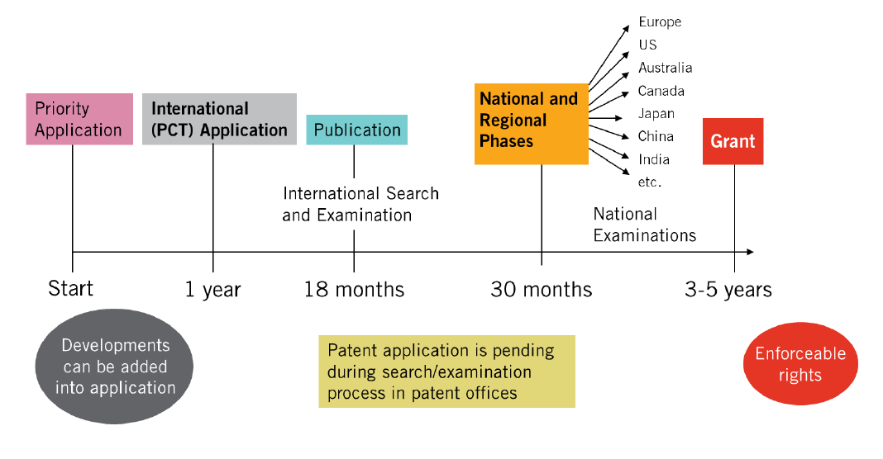
Intellectual Property
Copyright © University of Plymouth 2014 – All rights reserved

Slide 17
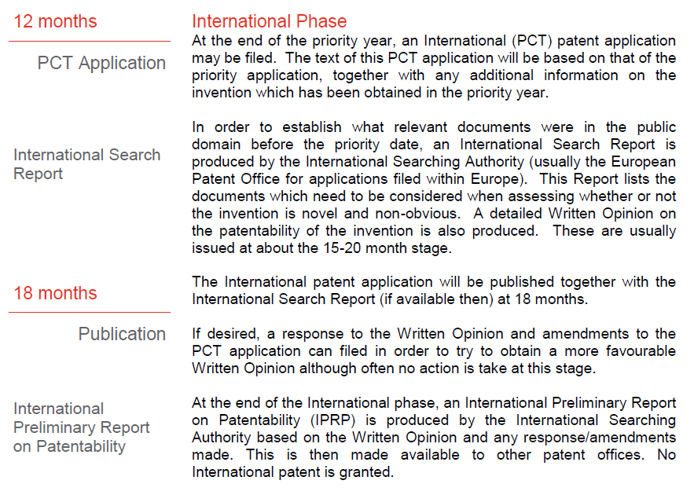
(Continued)
Intellectual Property
Copyright © University of Plymouth 2014 – All rights reserved

Slide 18
General IP Information
http://www.ipo.gov.uk/
https://www.gov.uk/browse/business/intellectual-property
http://www.wipo.int/about-ip/en/
British Library Business Centre http://www.bl.uk/bipc/
Inventors story http://www.mandyhaberman.com/advice
Copyright cases http://99designs.com/designer-blog/2013/04/19/5-famous-copyright-infringement-cases/
Patent database search - http://worldwide.espacenet.com/advancedSearch?locale=en_EP
Intro to EU design law http://author.acc.com/chapters/israel/loader.cfm?csModule=security/getfile&pageid=943731
Intellectual Property

